Slide 1
Lecture 01
Introduction

Slide 2
Introduction
Communication in the workplace

Slide 3
Importance of communication skills
Your work in business will involve communication—a lot of it—because communication is a major and essential part of the work of business.
Think about it, there is communication everywhere - with your boss, your senior, your colleagues, your subordinates, with other businesses, with customers, and whatnot!
Without exception, numerous surveys have found that communication (especially written communication) ranks at or near the top of the business skills needed for success.
But most people do not communicate well. Hence good communicators are in high demand.

Slide 4
Importance of communication skills
Whatever position you have in business, your performance will be judged largely by your ability to communicate.
If you perform and communicate well, you are likely to be rewarded with advancement.
And the higher you advance, the more you will need your communication ability.
The evidence is clear: Improving your communication skills improves your chances for success in business

Slide 5
Challenges for communicators

Slide 6
Challenges for business communicators
The Ongoing Development of New Information Technologies
With development of technology, as more and more means of acquiring, storing, retrieving, transmitting, and using information develop, what people do on the job becomes more and more information related.
You will need several kinds of literacy to do knowledge work.
Verbal literacy - The ability to use words to get things done.
Information literacy - The ability to find, evaluate, select, and use information

Slide 7
Challenges for business communicators
(continued)
Technological literacy - The ability to learn and use computer applications, as well as to understand their strengths and limitations
Visual literacy - The ability to interpret and assess visuals and to create visual components for your messages that convey information meaningfully, accurately, and efficiently
There has never been a more demanding—or exciting—time for business communication.

Slide 8
Challenges for business communicators
The Increasingly Global Nature of Business
With the information revolution has come rapid globalization. E-commerce, communication technologies, and the expansion of business-based economies throughout the world have forged new connections among countries.
The outsourcing of core business functions, such as manufacturing and customer service, to other countries is on the rise, and customers can come from all over the world.

Slide 9
Challenges for business communicators
(continued)
For this reason, you will need to be keenly aware that your assumptions about business and communication are not shared by everyone everywhere.
Your job as a communicator will be to learn about and honor others’ cultural orientations in such a way that you and your communication partners can work together for mutual benefit.
In short, developing cross cultural communication is very important.

Slide 10
Challenges for business communicators
Growing Diversity in the Workplace
An awareness of others’ preferences and values is crucial not just for cross-cultural communication but also for communication within one’s own country and one’s own organization.
We can expect to see more diverse workplaces, with employees of both sexes, various cultures, and all ages likely to be working together.
The globalization of business, immigration, the increasing entry of women into the workforce, and better access to education are all fueling this trend.

Slide 11
Categories of business communication

Slide 12
Categories of business communication
Internal-Operational communication
All the communication that occurs in conducting work within a business is internal operational.
Internal-operational communication takes many forms.
Ongoing discussions that senior management undertakes to determine the goals and processes of the business.
Orders and instructions that supervisors give employees.
Oral exchanges among employees about work matters.
Business reports, email messages, etc.

Slide 13
Categories of business communication
External-Operational communication
The work-related communicating that a business does with people and groups outside the business is external-operational communication.
This is the business’s communication with its publics—suppliers, service companies, customers, government agencies, the general public, and others.
For example - personal selling, telephoning, advertising, writing messages, etc.
External-Operational communication is important because every external message conveys an image of the company

Slide 14
Categories of business communication
Personal communication
Personal communication consists of non-business-related exchanges of information and feelings among people.
We are social animals. We have a need to communicate, and we will communicate even when we have little or nothing to say.
Although not an obvious part of the business’s plan of operation, personal communication can have a significant effect on the success of that plan.

Slide 15
Categories of business communication
Personal communication is important because -
It affects employee attitudes
It affects their performance and productivity.
It can enhance internal and external business communication (for example, writing personal message to a client, or including a brief personal note in an external-operational message, etc)

Slide 16
Communication networks

Slide 17
Communication networks of the organization
The formal network -
The formal network consists of the official, more stable lines of communication.
The informal network -
It consisting largely of personal communications, is highly complex and ever changing.
Informal communication, aka. the grapevine in management literature, this communication network is quite valuable to the company’s operations

Slide 18
Communication networks of the organization
The grapevine usually carries far more information than the formal communication system, and on many matters it is more effective in determining the course of an organization.
Skillful managers recognize the presence of the grapevine, and they know that the powerful people in this network are often not those at the top of the formal organizational hierarchy.
They find out who the talk leaders are and give them the information that will do the most good for the organization.
They also make management decisions that will cultivate positive talk

Slide 19
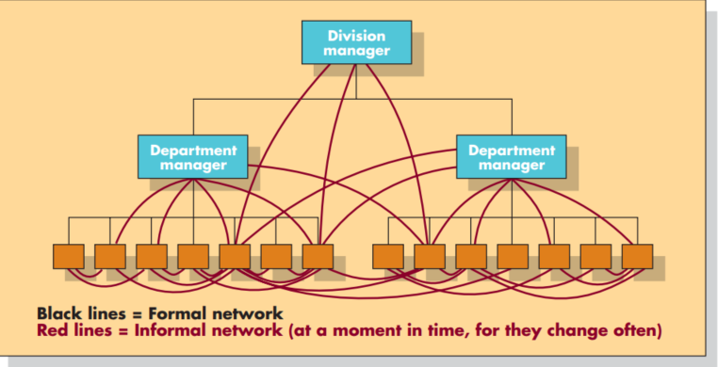
Communication networks of the organization

Slide 20
Discussion & Debate

Slide 21
Group discussion
To get a feel for how rapidly information technologies are changing and how significant the impact is on business, make a list of all the information technologies (devices and applications) that you’ve learned to use over the last five years. Now reflect on how your communication, work, and life have changed as a result of these technologies.
List the types of external-operational and internal-operational communication that occur in an organization with which you are familiar (school, fraternity, church, etc.)

Slide 22
Group discussion
Choose a certain national or regional culture, ethnicity, or generation—one different from your own—and find out what values the people in this demographic are generally known for. How might working or doing business with a person from one of these groups require you to adapt your own values and communication style?
Megan Cabot is one of 12 workers in Department X. She has strong leadership qualities, and all her co- workers look up to her. She dominates conversations with them and expresses strong viewpoints on most matters. Although she is a good worker, her dominating personality has caused problems for you, the new manager of Department X …. (continued)

Slide 23
Group discussion
… Today you directed your subordinates to change a certain work procedure. The change is one that has proven superior in the past whenever it has been tried. Soon after giving the directive, you noticed the workers talking in a group, with Megan the obvious leader. In a few minutes she appeared in your office. “We’ve thought it over,” she said. “Your production change won’t work.” Explain what is happening. How will you handle this situation?

Slide 24
Group discussion
After noticing that some workers were starting work late and finishing early, a department head wrote this message to subordinates:
It is apparent that many of you are not giving the company a full day’s work. Thus, the following procedures are implemented immediately:
a. After you clock in, you will proceed to your workstations and will be ready to begin work promptly at the start of the work period.
b. You will not take a coffee break or consume coffee on the job at the beginning of the work period. You will wait until your designated break times.
c. You will not participate in social gatherings at any time during the workday except during designated break periods.

Slide 25
Group discussion
d. You will terminate work activities no earlier than 10 minutes prior to the end of the work period. You will use the 10 minutes to put up equipment, clean equipment, and police the work area.
e. You will not queue up at the exit prior to the end of the work period
The message was not well received by the workers. In fact, it led to considerable anger and confusion. Using the discussion of communication planning in this chapter, explain where the department head’s problem-solving process went awry. What did he or she fail to take into account?

Slide 26
Debate
Is communication skill more important to the successful performance of a supervisor than to the successful performance of a company president? Defend your answer.
“People need to leave their cultures and values at the door when they come to work and just do business.” Discuss the possible merits and flaws of this attitude.
“Never mix business with personal matters—it just leads to damaged relationships, poor business decisions, or both.” In what ways might this be a fair statement? In what ways is it unwise advice?

Slide 27
Debate
Times are hard for Robo Solutions, a small local company that creates assembly-line robotics. Lately, the clients have been few and far between. But today the sales staff got encouraging news: James Pritchett, president of a nearby tool and die company, has inquired about the possibility of the company’s designing a series of computer-run robots for key processes in the plant. There’s a hitch, though; it’s Sara McCann’s turn to try to snare his business (and the

Slide 28
Debate
commission)—and Pritchett is known to prefer dealing with men. Do you, as Robo Solutions sales manager, send Sarah anyway, or do you send one of your male salespeople to get Pritchett’s business, giving Sarah a shot at the next potential client? How would you solve this communication—and ethics—problem?

Slide 29
Thank you

